Slide 1
Kelompok baking soda
Mailany – 4311931003
Rohima Putri Amalia – 4311811043
Mega Hasanatang – 4311811035

Slide 2
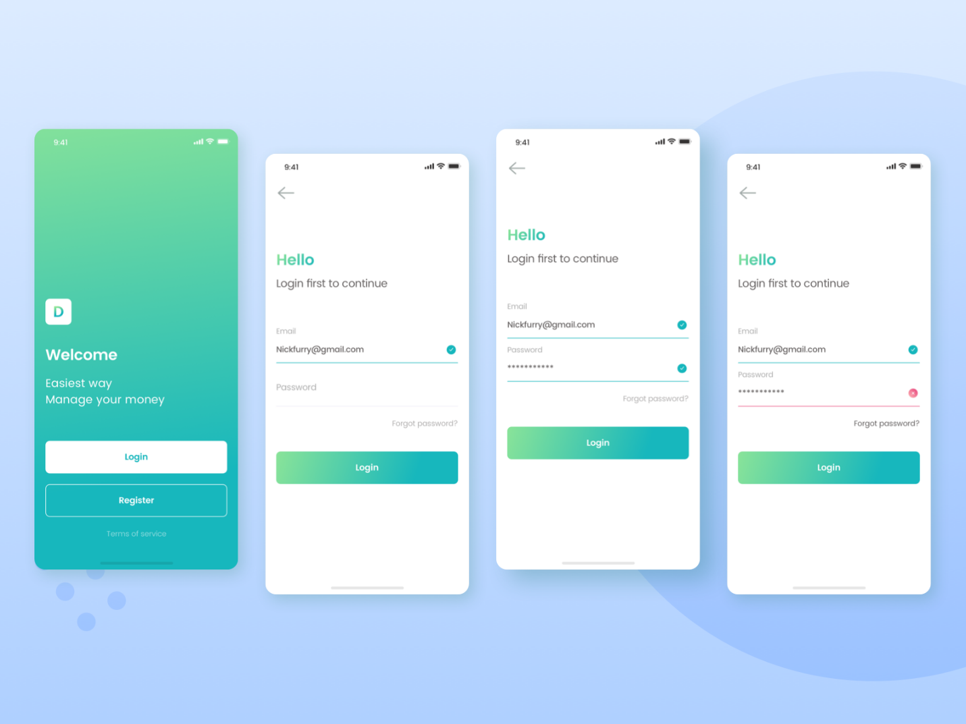
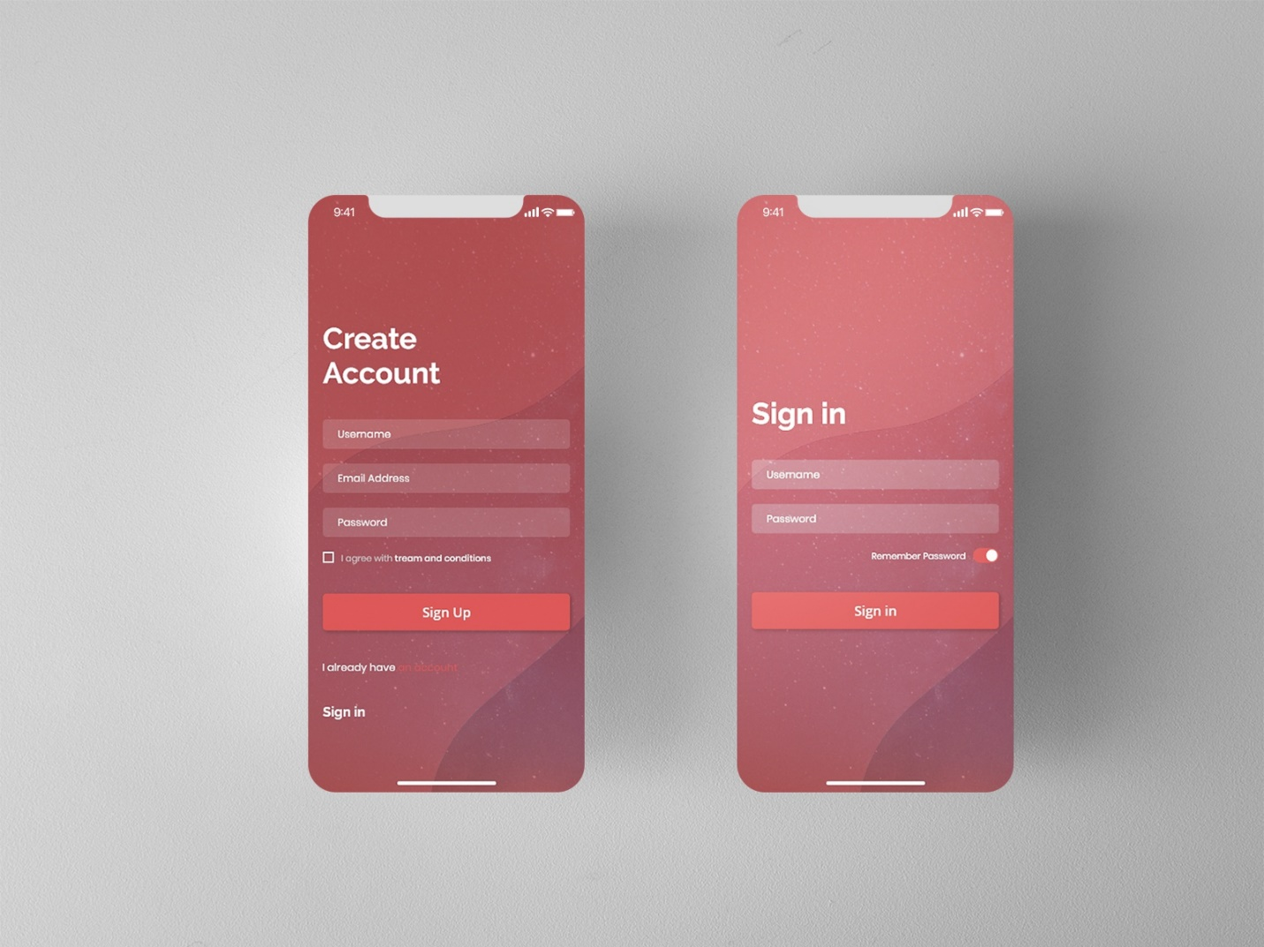
URL Acuan
https://dribbble.com/shots/10547150-Login-Flow-Kaya-Wallet-Apps
https://dribbble.com/shots/10535838-Sign-Up

Slide 3
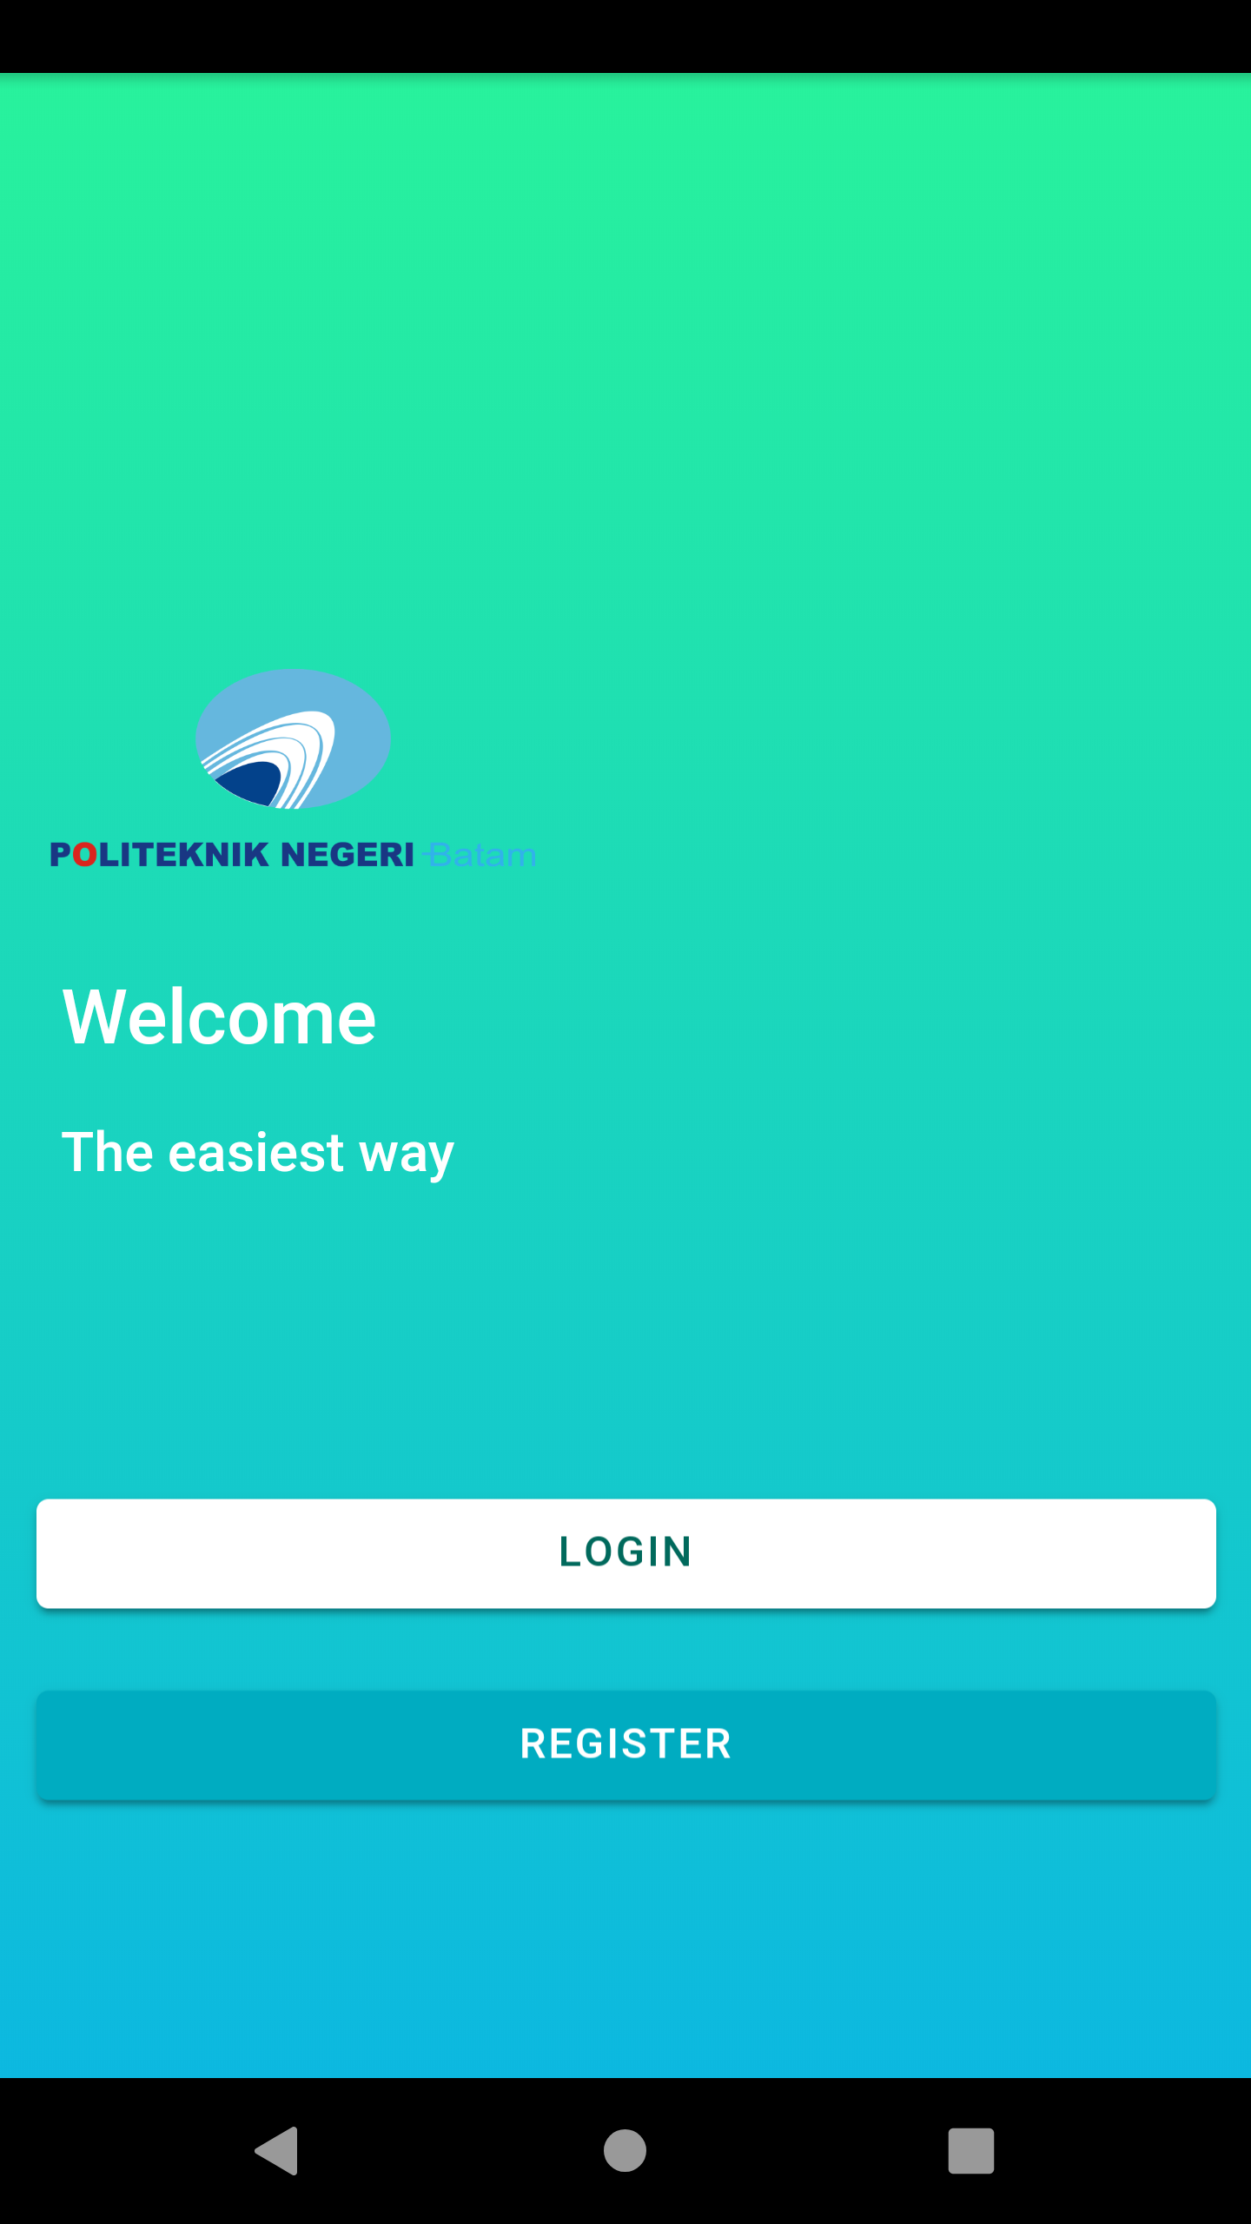
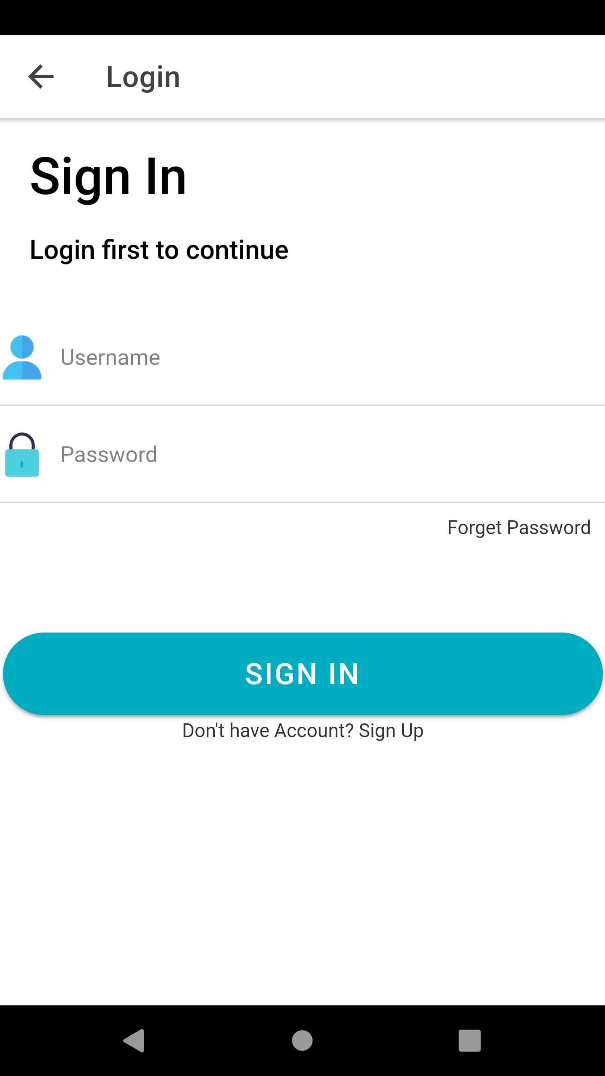
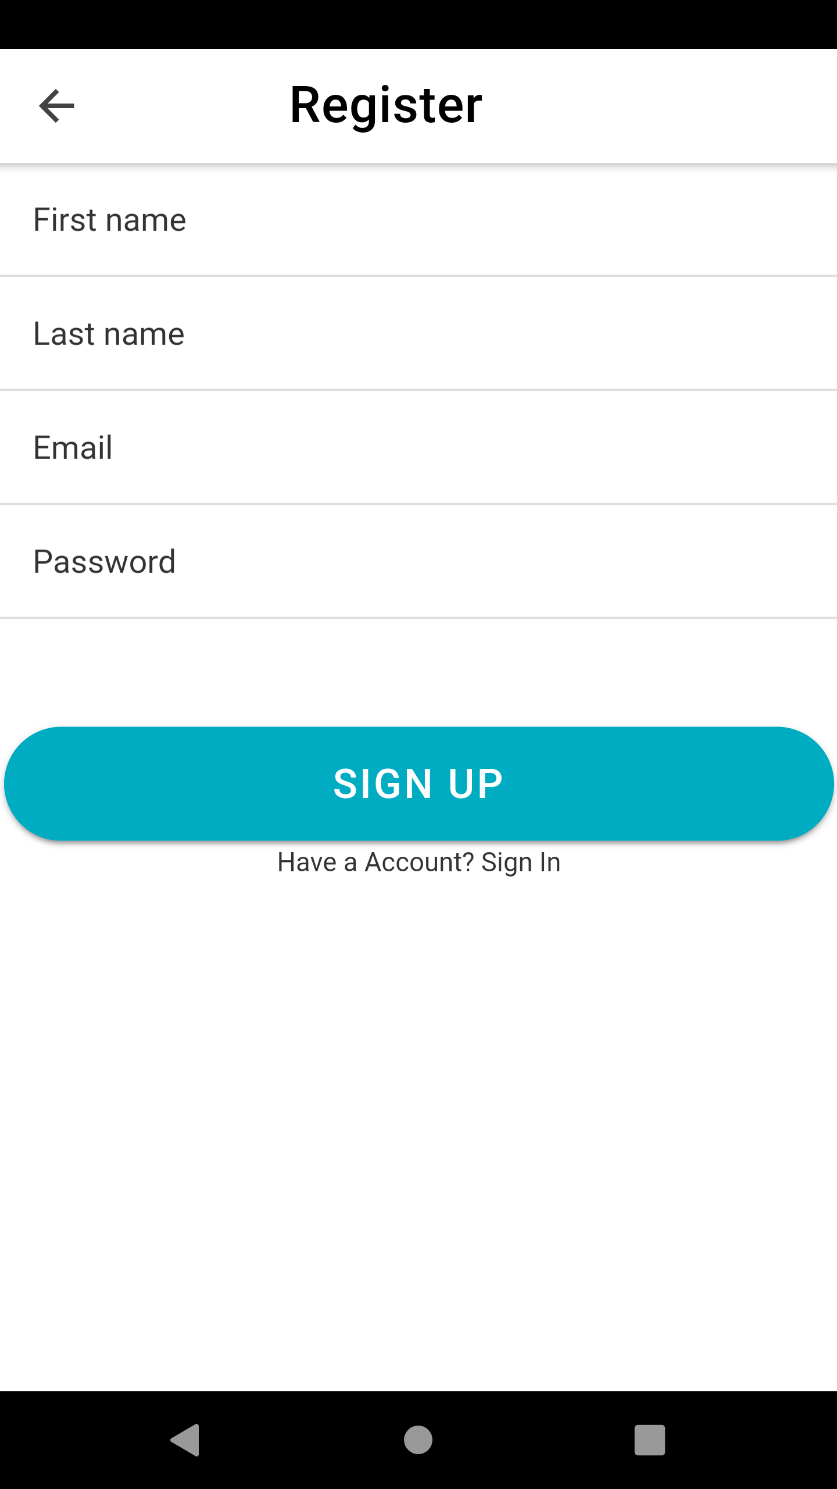
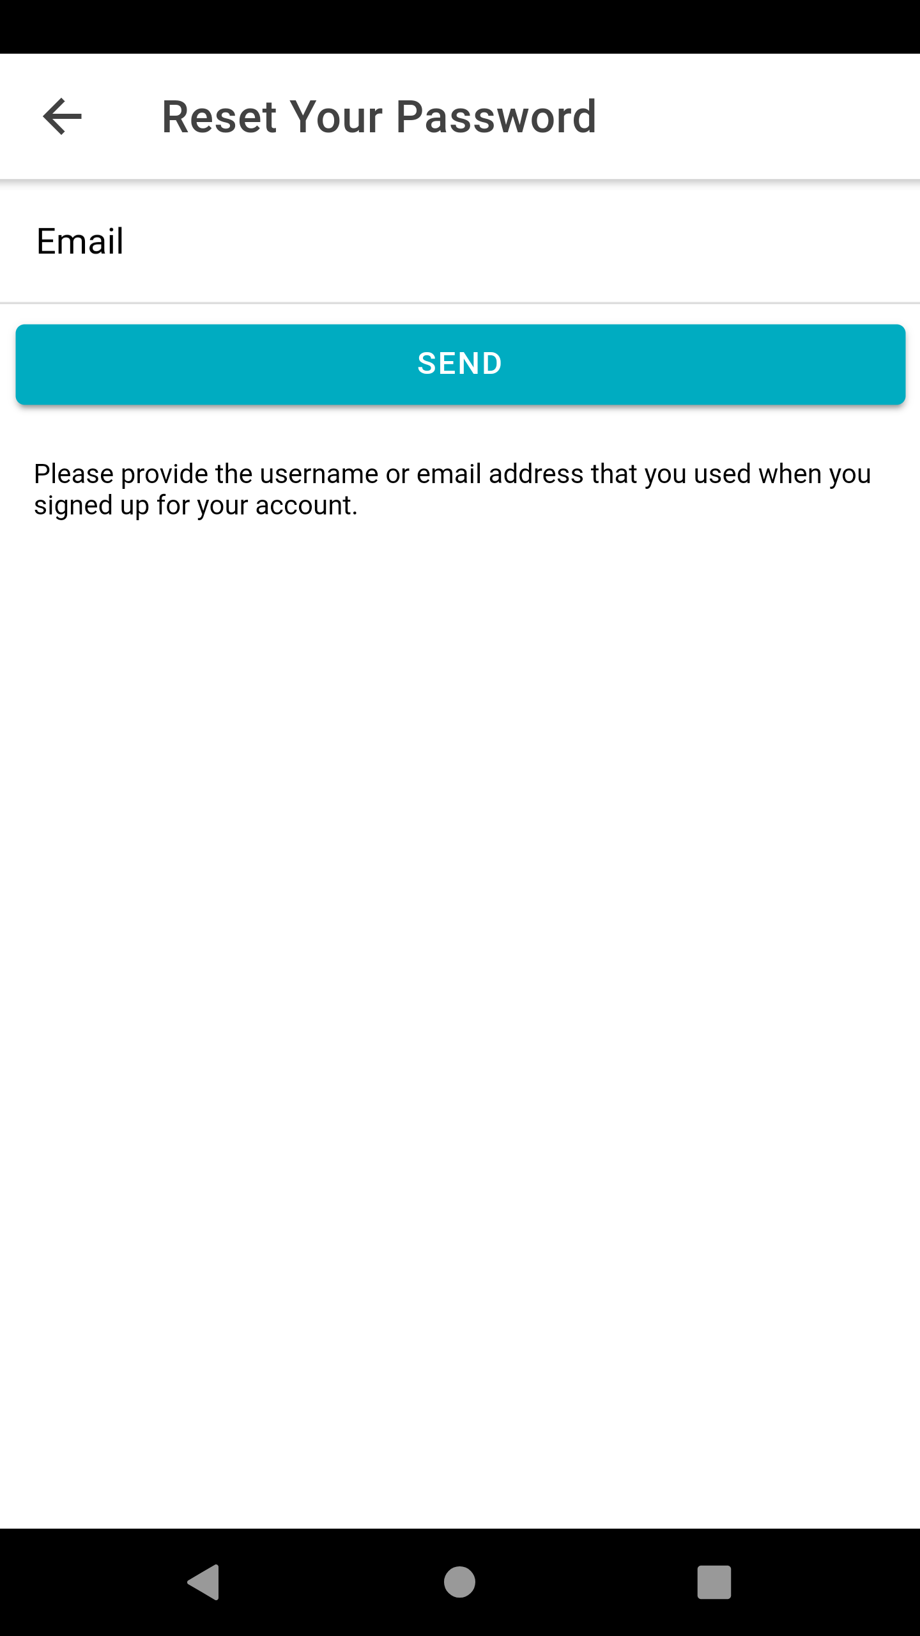
implementasi

Slide 4
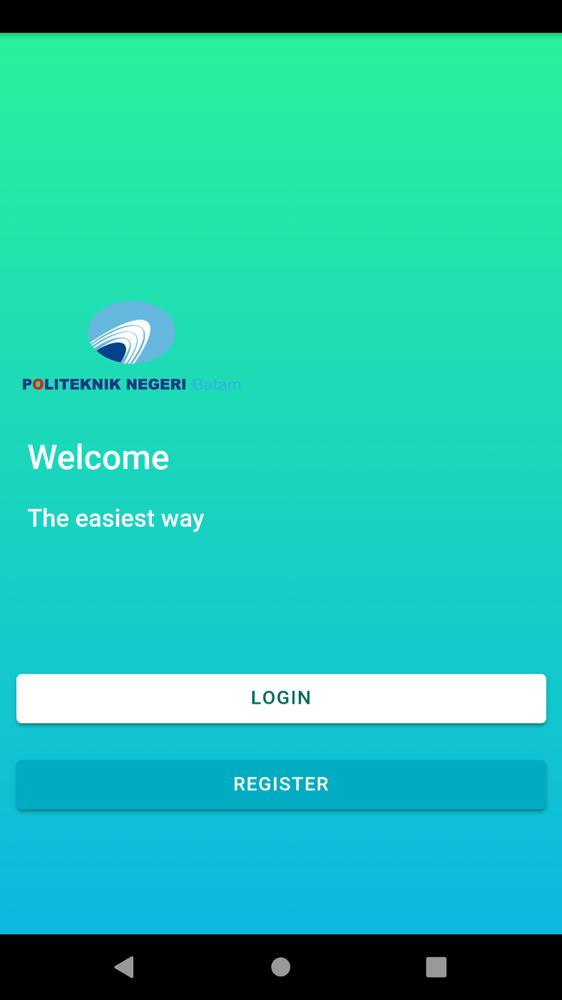
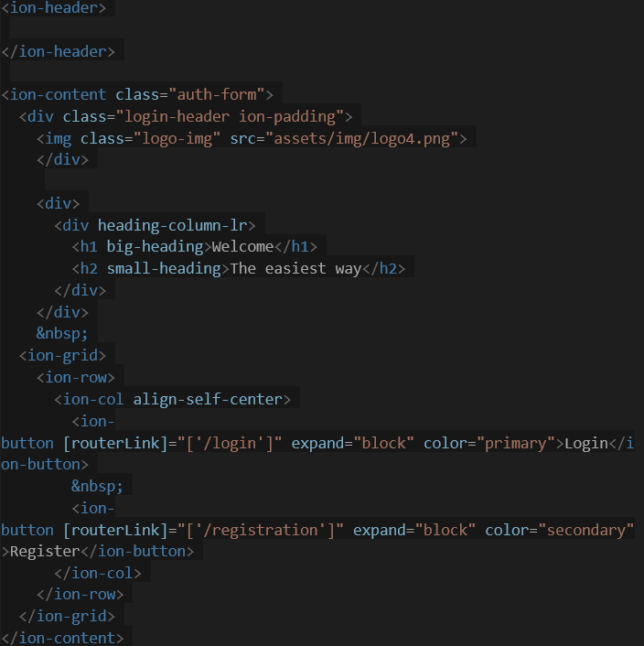
Menu UTAMA
Kode:

Slide 5
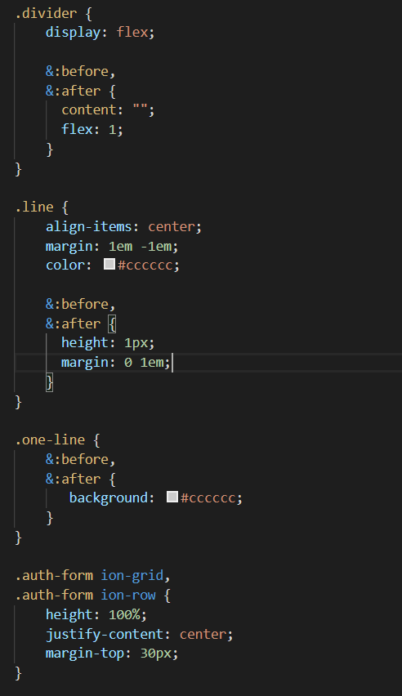
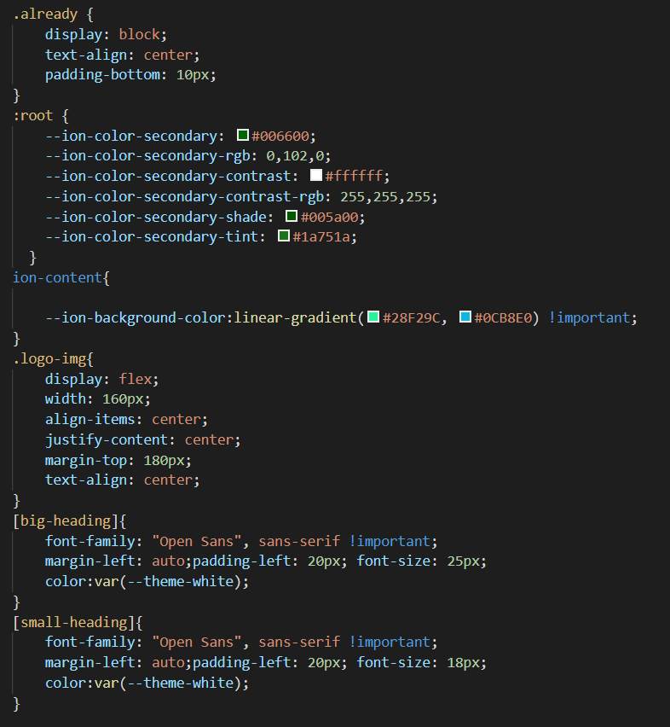
Menu UTAMA
SCSS:

Slide 6

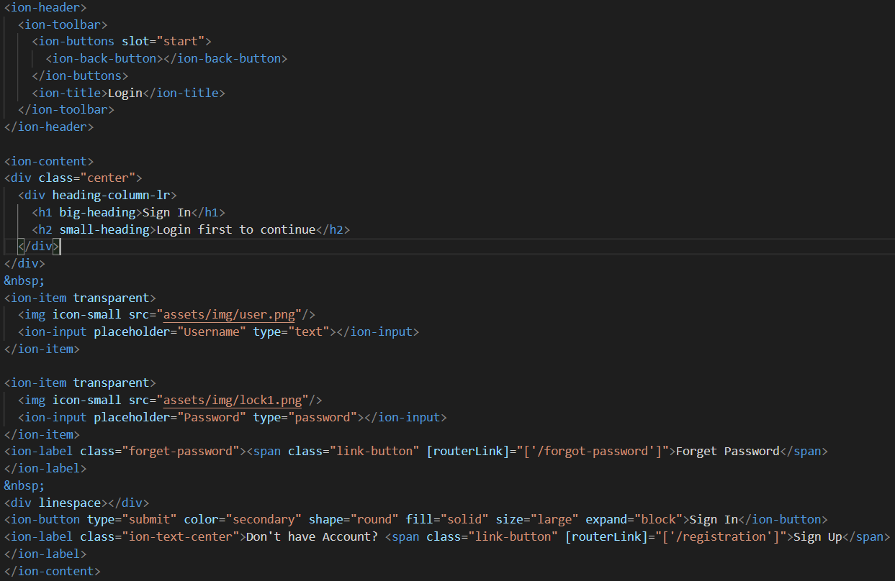
Menu LOGIN
Kode:

Slide 7
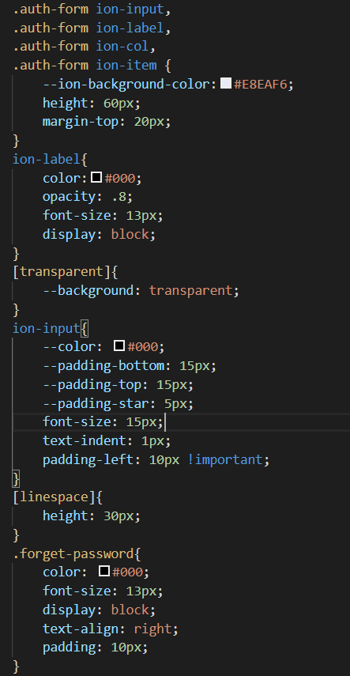
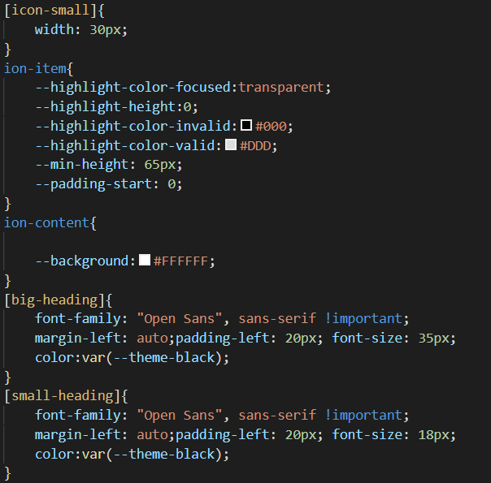
Menu LOGIN
SCSS:

Slide 8
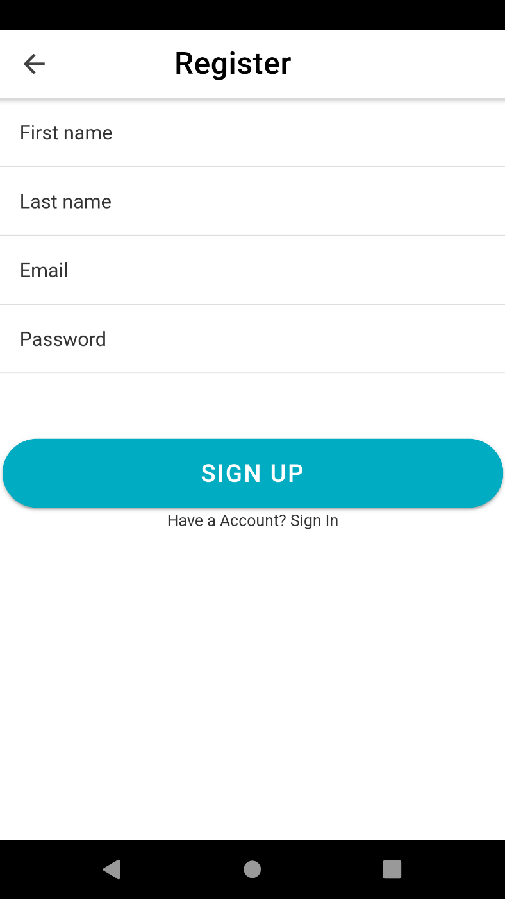
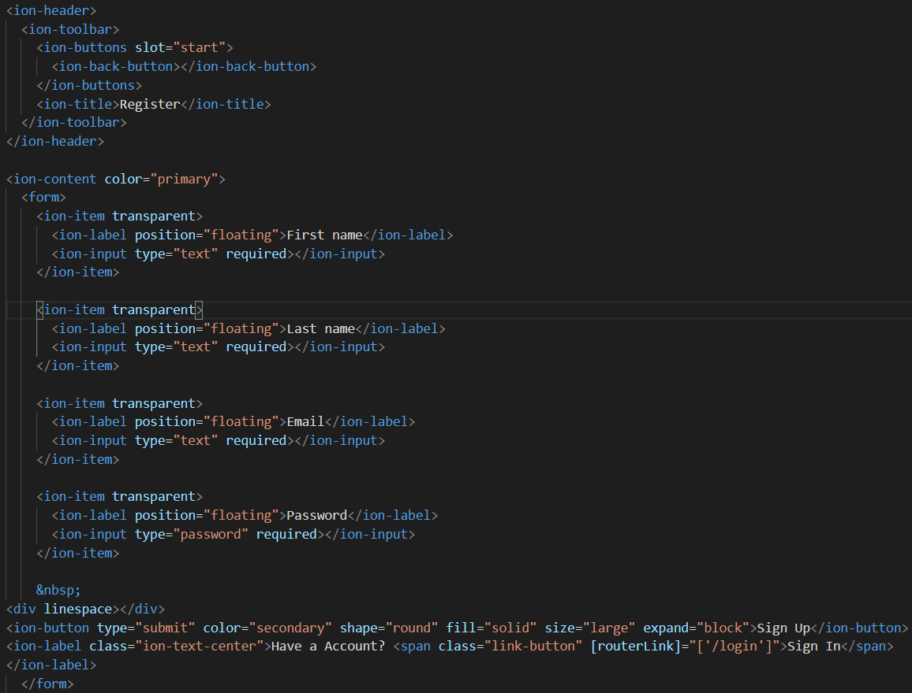
Menu REGISTRATION
Kode:

Slide 9
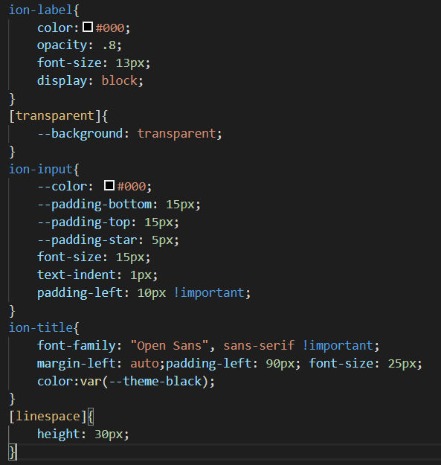
Menu REGISTRATION
SCSS:

Slide 10
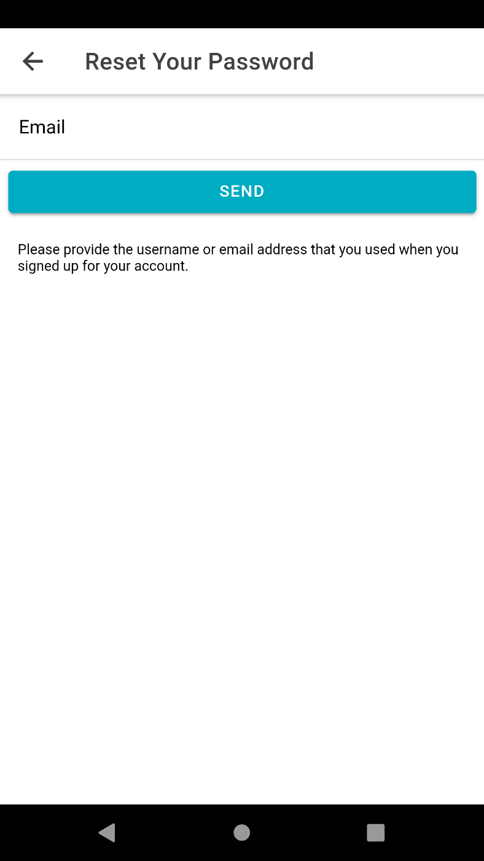
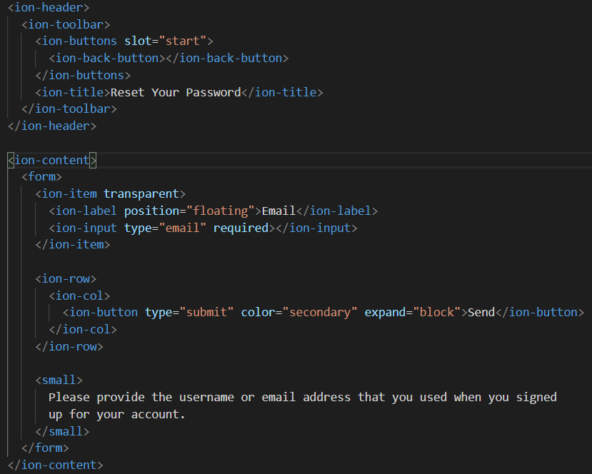
Menu forget password
Kode:

Slide 11
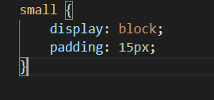
Menu forget password
SCSS:

Slide 12
TERIMA KASIH

